Slide 1
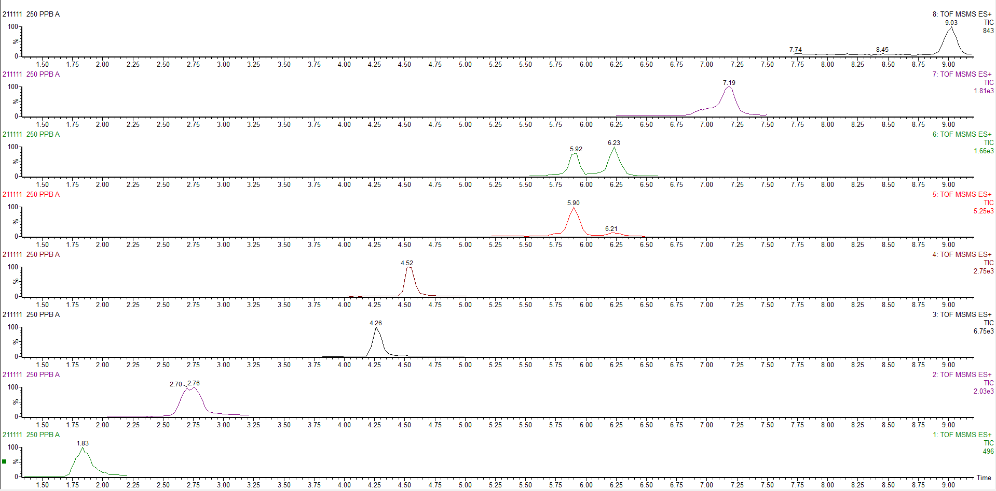
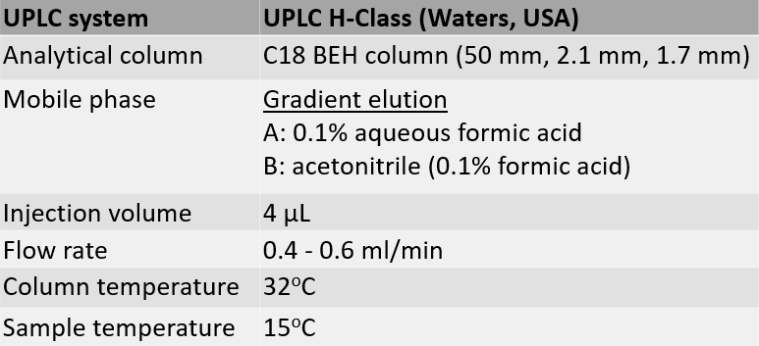
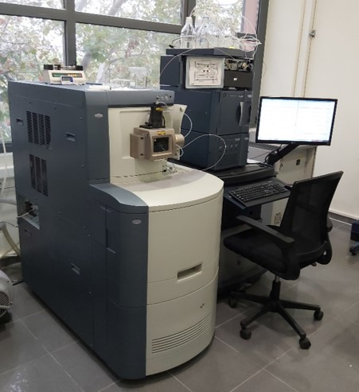
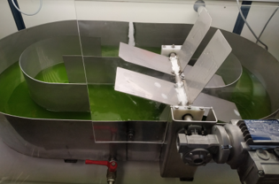
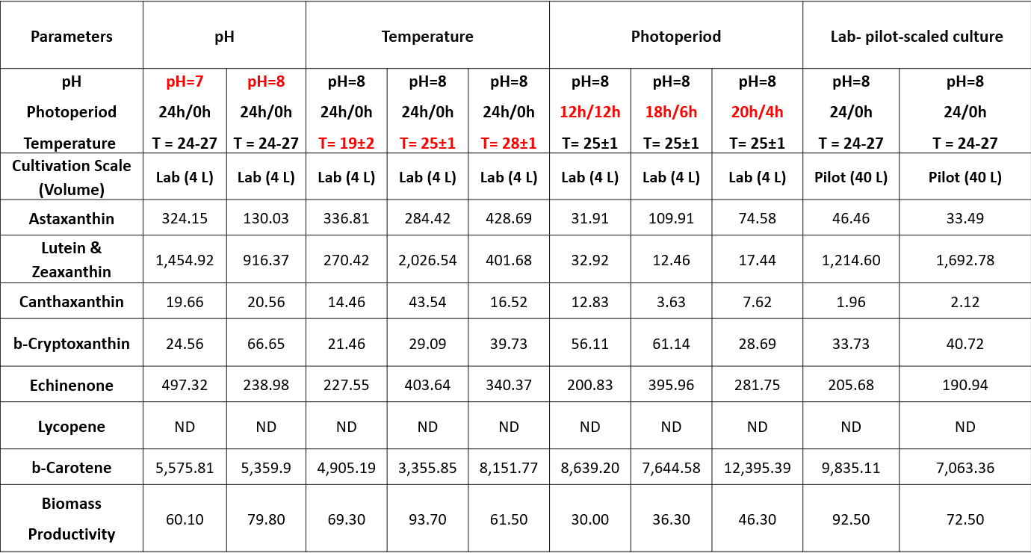
Carotenoid profile of Tetraselmis striata grown under optimal cultivation conditions in a lab pilot-scale raceway pond
Kampantais D.¹, Kanakis D.C.¹, Roussos E.¹, Ilia V.¹, Patrinou V.², Tekerlekopoulou A.G.² and Kotzamanis Y.¹
¹Laboratory of Fish Nutrition and Omics Technologies, Hellenic Centre for Marine Research, Institute of Marine Biology, Biotechnology and Aquaculture, 46,7 km Athens Sounio ave, 19013, Greece
²Department of Environmental Engineering, University of Patras, G. Seferi 2, Agrinio 30100, Greece
Poster code: M29
Microalgae are recognized as a valuable natural source of bioactive compounds, such as proteins, lipids, pigments and vitamins, for the aquaculture industry and their global market is projected to reach approximately 53.43 billion USD by 2026. Among the few high-value added products derived from microalgae, carotenoids have made a real impact on the global economy. Several carotenoids have been identified in microalgae, such as b-carotene, astaxanthin and lutein, which have the most significant market potential, although violaxanthin, antheraxanthin, zeaxanthin and neoxanthin are also commonly found.
Objective: The objective of this study was to evaluate the carotenoid profile of the microalgae Tetraselmis striata cultivated in laboratory and lab pilot-scale production, under different pH, temperature and photoperiod, to determine the optimum conditions for cell growth and carotenoid production.
Introduction
Standard solutions (astaxanthin, lutein, zeaxanthin, canthaxanthin, echinenone, lycopene, b-cryptoxanthin, b-carotene)
Internal standard (trans-8'-apo-beta-Caroten-8'-al)
Carotenoid extraction
Centrifugation of wet microalgae biomass (7,000rpm/ 5ºC/ 5mins)
Freeze-dry (3 days)
Weight 15 mg microalgae +38.50 μL internal standard (10 ppm)
Vortex for 30s
+450μL MeOH/H₂O (1:1)
Shake for 1 hour
Extraction with chloroform until colorless
Evaporation
Material and methods
Beta-carotene
Lycopene
Echinenone
Beta-cryptoxanthin
Canthaxanthin
Trans-8'-apo-beta-Caroten-8'-al
Saponification protocol
Reconstitution in 4 ml Petroleum ether/Diethyl ether (1:1)
+4 ml KOH 10% in MEOH
Overnight stirring
+4 ml ultrapure H₂O
Extraction with P. ether / D. ether until colorless
Evaporation
Reconstitution in 1 ml MeOH/CHCl₃ (9:1)
0.45μm PVDF syringe filter
Injection in UPLC-QTOF
Lutein & zeaxanthin
Figure 1. Freeze-dried T. striata biomass
Astaxanthin
Figure 2. LC-MS chromatogram of carotenoid standard solutions and internal standard
Table 1. Chromatographic conditions of Acquity UPLC H-Class
Non-saponification protocol
Reconstitution in 1 ml MeOH/CHCl₃ (9:1)
0.45μm PVDF syringe filter
Injection in UPLC-QTOF
1
Figure 3. Acquity UPLC H-Class UPLC coupled with Q-TOF Premier mass spectrometer
Figure 4. Pilot-scale raceway pond (culture volume 40 L)
The targeted carotenoids were detected in all the samples except lycopene
Combination of a rich carotenoid profile and optimum biomass productivity of T. striata
cultivated in laboratory scale was observed at
25ºC
constant illumination (56 μmol m⁻² s⁻¹ intensity Photosynthetic Photon Flux Density)
pH=8
Up-scale cultivation in 40 L capacity paddlewheel stainless steel raceway pond
under optimum conditions presented:
b-carotene (7,063.4 – 9,835.1 mg/kg dry biomass)
lutein & zeaxanthin (1,214.6 - 1,692.8 mg/kg dry biomass)
echinenone (190.9 - 205.7 mg/kg dry biomass)
b-cryptoxanthin (33.7 - 40.7 mg/kg dry biomass)
astaxanthin (33.5 – 46.5 mg/kg dry biomass)
canthaxanthin (1.96 - 2.12 mg/kg dry biomass)
Results
Table 2. Biomass productivity (calculated in mg biomass L⁻¹d⁻¹) and carotenoid profile of T. striata cultivated in lab and lab pilot-scale 40 L raceway pond under different pH, temperature and photoperiod conditions. Carotenoid concentrations are in mg/kg of dry microalgae biomass.
Microalgae T. striata can be considered as a potential natural source of carotenoid compounds, especially due to its high concentration in b-carotene, lutein & zeaxanthin, when cultivated at 25ºC, constant illumination and pH=8.
Acknowledgements
The project "Large-scale cultivation of microalgae and utilization of the biomass, was produced as an alternative raw material in fish feed-AlgaFeed4Fish" (MIS 5045858, FK 80916), was co-funded by European (European Regional Development Fund) and National Resources (General Secretariat for Research and Innovation), in the context of the Operational Program "Competitiveness, Entrepreneurship and Innovation (EPANEK, NSRF 2014-2020), specifically through the Action "Special Actions" - "Aquaculture" - "Industrial Materials" - "Open Innovation in Culture".
Conclusions

