Slide 1
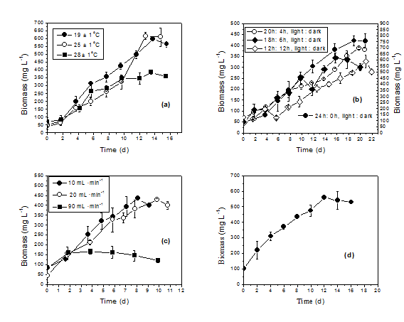
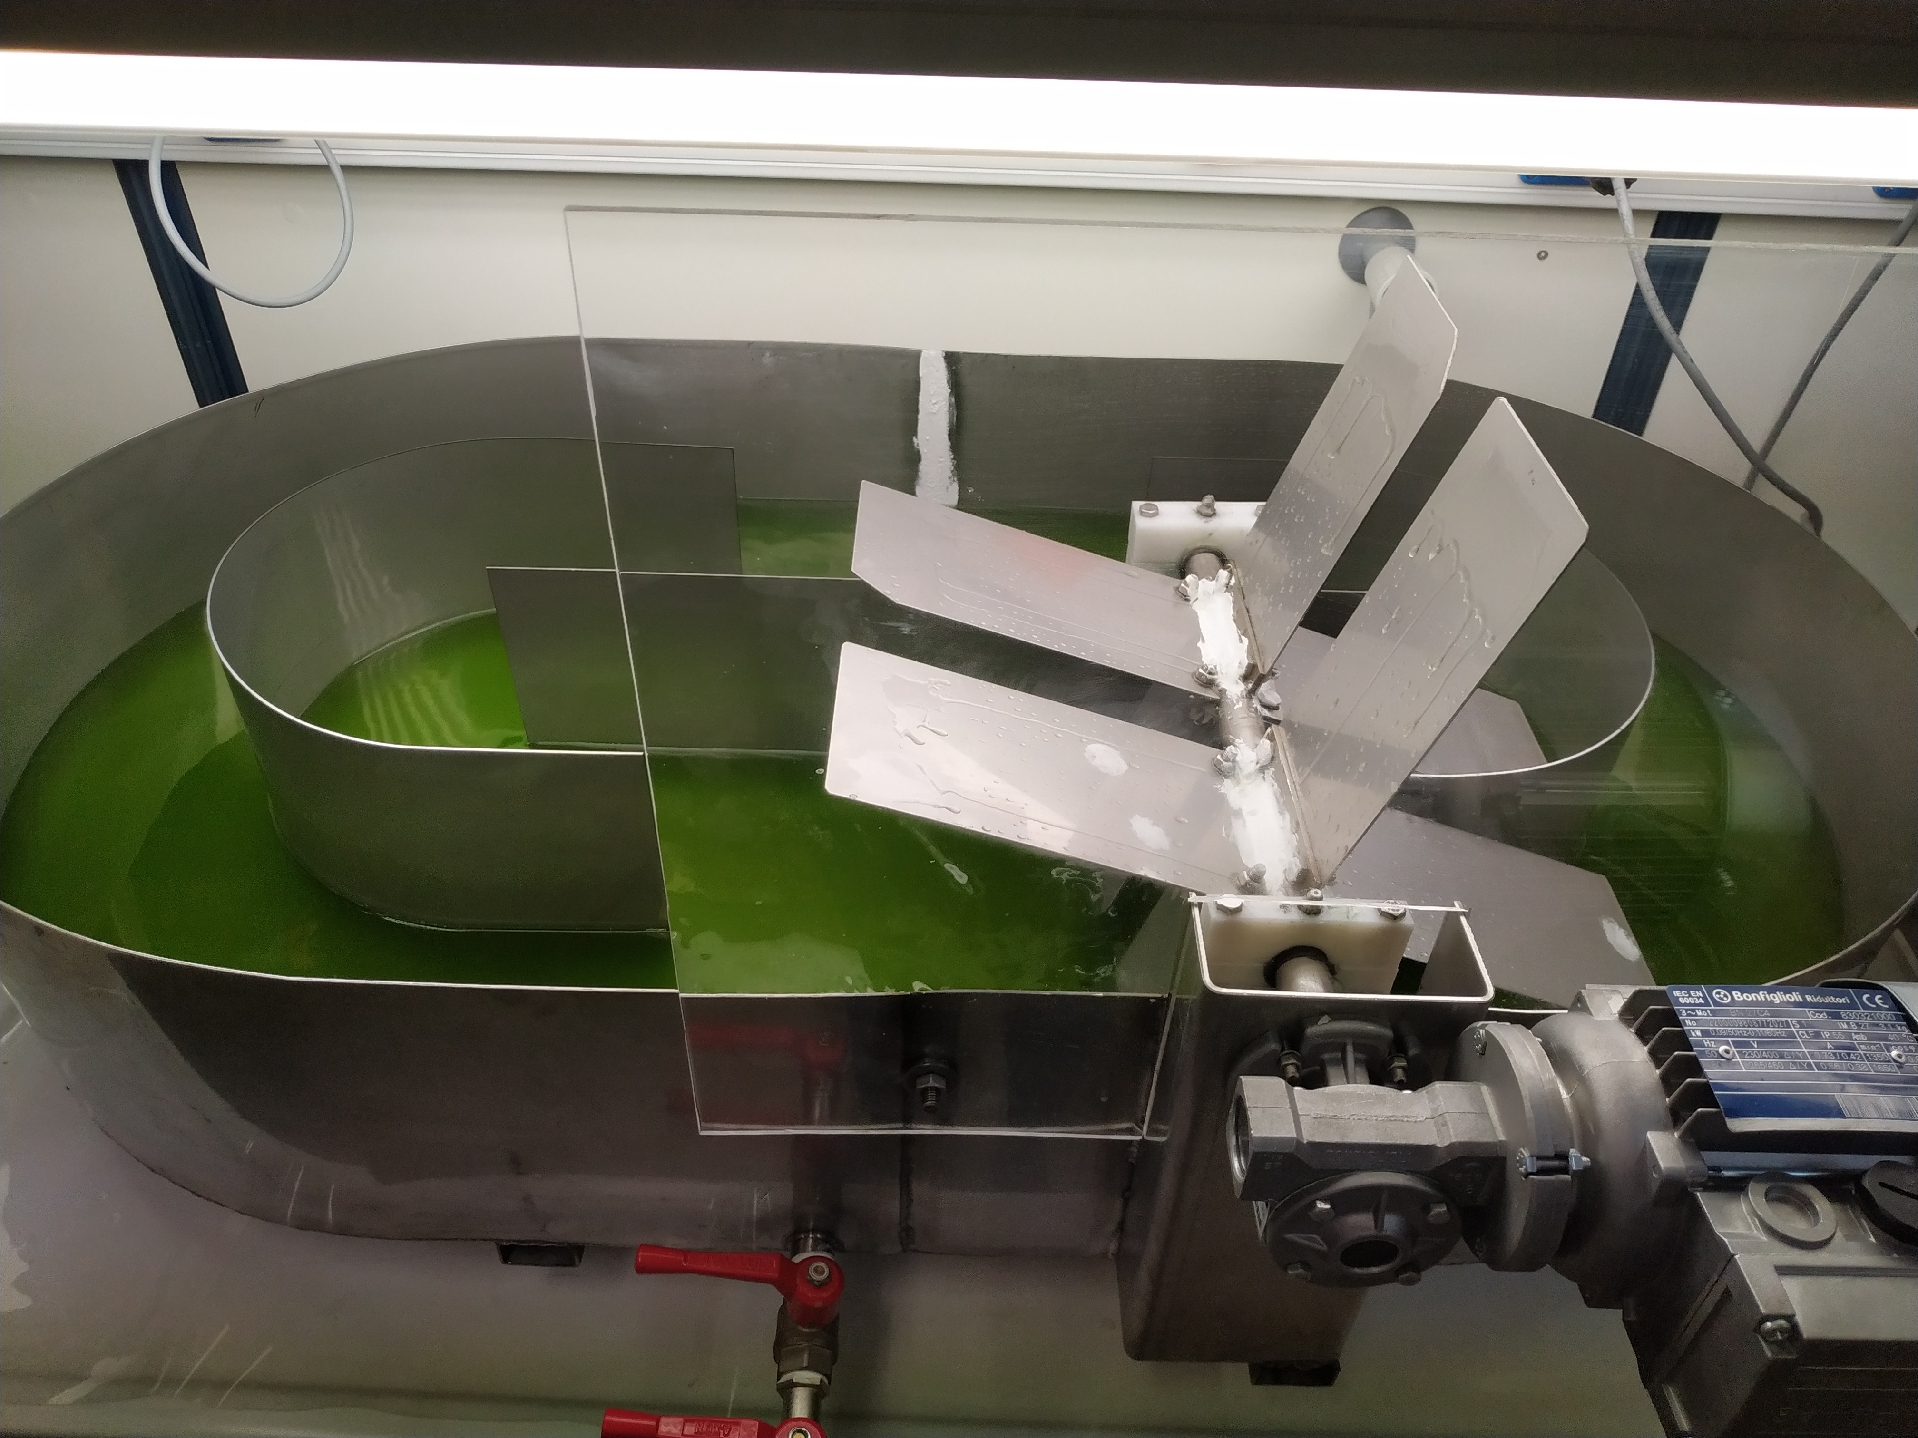
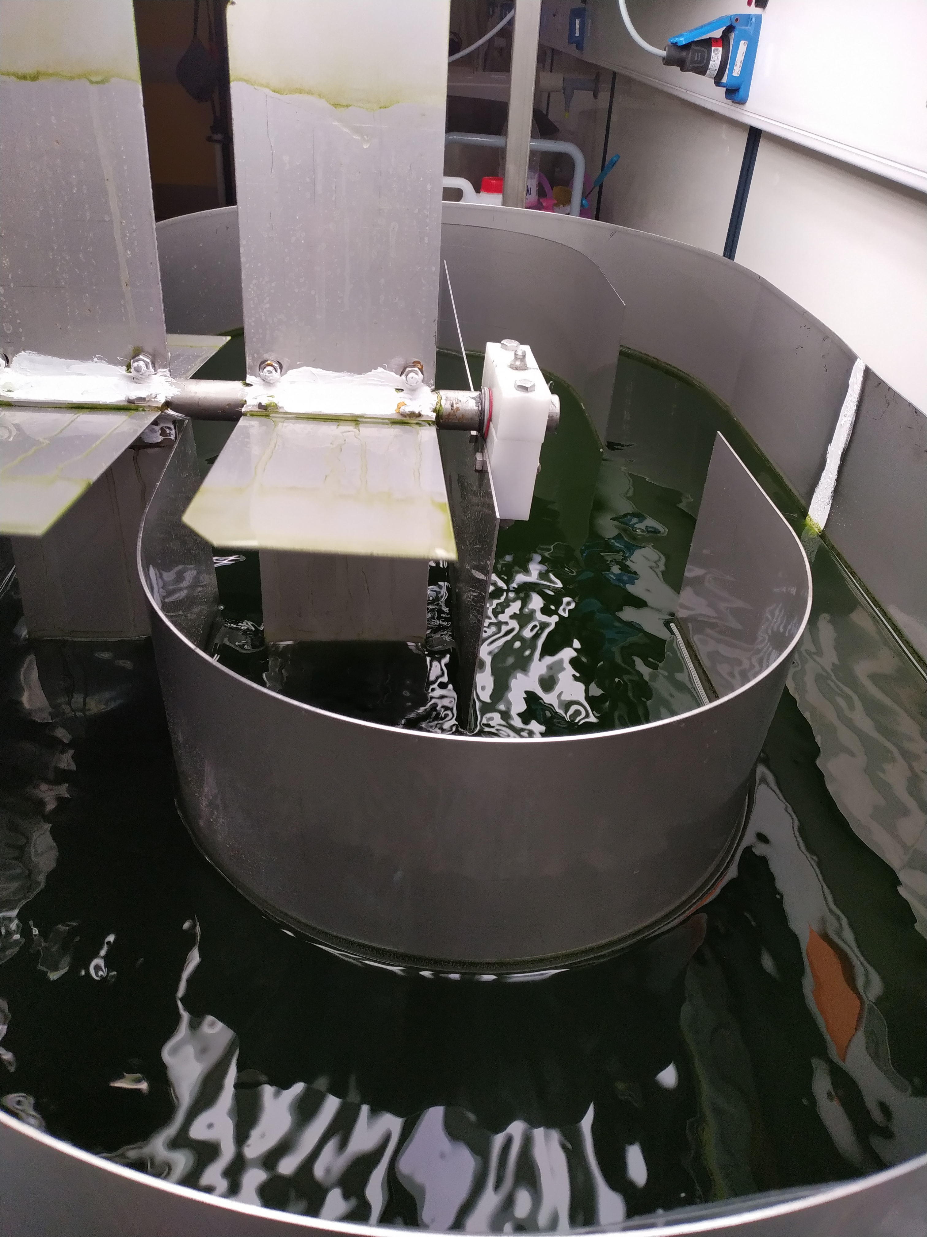
Laboratory and pilot-scale cultivation of Tetraselmis striata under optimized growth conditions for fish feed production
V. Patrinou ¹, A. Daskalaki ², S. Papanikolas ^{1,5}, D. Kampantais ³, D. C. Kanakis ³, C.N. Economou ⁴, D. Bokas ⁵, Y. Kotzamanis ³, D.V. Vayenas ⁴, G. Aggelis ² and A.G. Tekerlekopoulou ^{1,*}
¹Department of Environmental Engineering, University of Patras, G. Seferi 2, Agrinio 30100, Greece
²Department of Biology, University of Patras, Patras 26500, Greece
³Hellenic Centre for Marine Research / Institute of Marine Biology, Biotechnology and Aquaculture, Iera Odos 75, Athens 11855, Greece
⁴Department of Chemical Engineering, University of Patras, Patras 26500, Greece
⁵PLAGTON S.A., Konaki Skentou, Municipality of Xiromerou, Aitoloakarnania, Greece
INTRODUCTION
Tetraselmis striata was cultivated in drilling waters (salinity 29 ‰) obtained from the commercial fishery of Plagton S.A.. The effects of temperature, photoperiod and CO₂ flow rate on the growth and biomass composition of Tetraselmis striata were examined in laboratory conditions.
CULTURE CONDITIONS AND GROWTH MEDIUM
The cultivation media of Tetraselmis striata was the commercial fertilizer Nutri-Leef (30%-TN, 10%-P, 10%-K) together with an inorganic carbon source (0.18 gr L⁻¹, NaHCO₃) at pH 8. The fertilized waters were autoclaved and experiments conducted under non-aseptic conditions. pH was adjusted manually between 8.0-8.3 by using NaOH or HCl. Illumination was provided by two fluorescent lamps of 56 μmol m⁻² s⁻¹ intensity which were turned off to provide dark conditions. For the temperature experiments, thermostats were positioned inside the photobioreactors and flow meters were used to regulate CO₂ flow. The bioreactors used in the lab-scale experiments were glass aquariums with 4 L working volume and stirring was provided by a mini centrifugal air pump with a flow rate of 380 L h⁻¹.
RESULTS AND DISSCUSSION
The initial nutrient concentrations recorded in all experiments ranged from 77.2 to 89.8 mg L⁻¹ , 9.5 to 12.8 mg L⁻¹ and from 26.5 up to 92 mg L⁻¹ for TN, PO₄ ³⁻ and d-COD respectively, while initial N:P ratios were between 7.6 to 8.51 . In all experimental sets the inoculum was constant with a biomass concentration of 80 ± 30 mg L⁻¹. Temperatures of 19 ± 1ºC, 25 ± 1ºC and 28 ± 1ºC were examined under conditions of continuous illumination (24:0 hrs, L (Light): D (Dark)). The highest biomass productivity of 93.7 mg L⁻¹ d⁻¹ was achieved at 25ºC (Table 1). High biomass productivity of around 70.0 mg L⁻¹ d⁻¹ was also achieved at 19ºC but when the temperature was increased to 28ºC biomass productivity reduced significantly (Figure 1a). The temperatures of 19ºC and 25ºC were not only favourable for biomass production but also led to higher nutrient reduction rates (Table 1).
Figure 1. Biomass production of T. striata under different conditions of (a) temperature,
(b) photoperiod, (c) CO₂ flow rate in the laboratory-scale reactor, and d) in the pilot-scale
reactor.
Table 1. Effects of temperature, photoperiod and CO₂ flow rate on nutrient reduction rates.
a
b
Growth condition | Biomass productivity (mg L⁻¹d⁻¹) | Specific growth rate (d⁻¹) | % Reduction Rates
 |  |  | TN NO₃⁻-N NH₄⁺-N PO₄³⁻ d-COD
19 ± 1ºC | 69.3 ± 3.9 | 0.237 | 99.1 ± 0.1 | 61.0 ± 0.7 | 99.8 ± 0.1 | 99.7 ± 0.1 | 53.0 ± 2.3
25 ± 1ºC | 93.7 ± 11.5 | 0.283 | 95.5 ± 1.6 | 50.0 ± 1.3 | 99.2 ± 0.1 | 100 ± 0.1 | 72.5 ± 1.0
28 ± 1ºC | 61.5 ± 1.3 | 0.223 | 95.4 ± 2.1 | 56.0 ± 1.3 | 94.5 ± 0.1 | 99.6 ±0.1 | N/R
24:0 L:D | 93.7 ± 11.5 | 0.283 | 95.5 ± 1.6 | 50.0 ± 1.3 | 99.2 ± 0.1 | 100 ± 0.1 | 72.5 ± 1.0
20:4 L:D | 46.3 ± 3.1 | 0.136 | 74.0 ± 2.7 | N/R | 62.6 ± 1.8 | 98.7 ± 0.1 | N/R
18:6 L:D | 36.3 ± 14.2 | 0.208 | 76.8 ± 6.1 | N/R | 52.0 ± 3.8 | 97.7 ± 0.1 | 47.0 ± 8.0
12:12 L:D | 30.0 ± 2.6 | 0.118 | 61.01 ± 2.5 | N/R | 47.8 ± 0.5 | 96.8 ± 0.1 | 68.8 ± 2.0
10 mL. min⁻¹ | 87.5 ± 16.4 | 0.262 | 91.8 ± 0.4 | 91.0 ± 0.6 | 99.6 ± 0.1 | 68.0 ± 0.8 | 20.6 ± 4.0
20 mL. min⁻¹ | 73.8 ± 10.1 | 0.216 | 78.1 ± 1.2 | 32.0 ± 0.21 | 82.8 ± 1.9 | 52.8 ± 0.7 | N/R
90 mL. min⁻¹ | 20.3 ± 2.2 | 0.050 | N/R | N/R | N/R | N/R | N/R
Open pond | 92.7± 14.7 | 0.201 | 67.2 ± 0.2 | 44.0 ± 1.3 | 53.0 ± 0.1 | 97.0 ± 0.2 | N/R
Figure 2. Growth of Tetraselmis striata in the pilot scale raceway pond. a) Cell density on first day of the experiment, b) cell density on the last day.
Table 2. Effects of temperature, photoperiod and CO₂ flow rate on biomass composition.
Experiments were conducted at 25ºC to study the photoperiods of 20:4, 18:6, 12:12h L:D. Biomass was significantly affected by light absence and as the dark period was lengthened biomass efficiency reduced. The highest biomass productivities recorded at 24:0 and 20:4 L:D reached a maximum of 93.7 and 46.3 mg L⁻¹ d⁻¹, respectively.
Regarding nutrient removal, higher reduction rates recorded when light was adequate. Enhanced protein contents were observed mainly in the 24:0 and 20:4 L:D photoperiods where nitrogen assimilation was higher. Total chlorophyll, carbohydrates and lipids reduced as the dark period was extended (Table 2). Under continuous illumination the effect of pure CO₂ was also studied by applying flow rates of 10, 20 and 90 mL min⁻¹. Experiments revealed that T. striata could not tolerate the high flow rate of 90 mL.min⁻¹, as it significantly affected the pH of the growth substrate resulting in values of 5.8-6.5. The highest biomass productivity was recorded at 10 mL min⁻¹ flow rate and reached 87.5 mg L⁻¹ d⁻¹.
Pigment content at 10 mL . min⁻¹ was the same as that recorded in the optimum growth conditions (5.2%) while at higher CO₂ concentrations, both biomass productivity and pigment content decreased. Protein content (36.6-41.8%) decreased as the CO₂ flow rate increased, while carbohydrate content ranged between 10.3-11.5%.
In the pilot-scale reactor T. striata was cultivated in an open raceway pond of 40 L capacity applying the optimum growth conditions of 25ºC and 24:0 L:D (Figure 2 a, b). CO₂ was not added to the pilot reactor as a cost-cutting measure that could enable future full-scale cultivation of T. striata. The strain presented similar biomass productivity and quality as that obtained with the optimum lab-scale growth conditions. Amino acid and fatty acid obtained from the open pilot-scale pond showed that T. striata could produce high essential amino acid content (21.5%) and a high essential to non-essential amino acid ratio (EAA/NEAA) of 1.01. Leucine was the dominant amino acid (4.6%). Finally, fatty acid analysis revealed that the microalga produced a high percentage of EPA (22.2%) and it should be mentioned that this polyunsaturated fatty acid is crucial for nutrition.
Growth condition | Intracellular Content (% d.w)
 | Proteins | Lipids | Carbohydrates | Total chlorophyll | Total carotenoids
19 ± 1ºC | 43.0 ± 1.00 | 26.7 ± 1.70 | 16.0 ± 4.00 | 3.4 ± 0.10 | 0.42 ± 0.03
25 ± 1ºC | 38.7 ± 2.40 | 30.2 ± 1.50 | 20.4 ± 2.20 | 5.1 ± 1.20 | 0.51 ± 0.10
28 ± 1ºC | 41.6 ± 2.10 | 26.2 ± 1.30 | 13.50 ± 0.40 | 2.7 ± 0.05 | 0.27 ± 0.05
24:0 L:D | 38.7 ± 2.40 | 30.2 ± 1.50 | 20.4 ± 2.20 | 5.1 ± 1.20 | 0.51 ± 0.10
20:4 L:D | 53.2 ± 0.50 | 28.5 ± 3.80 | 15.6 ± 1.40 | 4.2 ± 0.10 | 0.60 ± 0.10
18:6 L:D | 50.4 ± 1.20 | 25.8 ± 1.10 | 14.4 ± 1.60 | 2.8 ± 0.60 | 0.53 ± 0.01
12:12 L:D | 47.0 ± 1.80 | 24.7 ± 2.50 | 13.8 ± 0.50 | 3.8 ± 0.40 | 0.59 ± 0.20
10 mL. min⁻¹ | 41.8 ± 1.70 | 27.3 ± 1.50 | 10.3 ± 2.60 | 5.2 ± 0.25 | 1.13 ± 0.30
20 mL. min⁻¹ | 36.6 ± 3.80 | 22.5 ± 1.50 | 11.5 ± 1.30 | 3.5 ± 0.40 | 0.78 ± 0.10
90 mL. min⁻¹ | 25.4 ± 0.20 | 19.0 ± 2.60 | 11.5 ± 0.70 | 1.4 ± 0.07 | 0.19 ± 0.10
Open pond | 49.9 ± 0.98 | 27.7 ± 3.4 | 21.2 ± 2.6 | 4.8 ± 0.30 | 1.15 ± 0.02
CUNCLUSIONS
Under the optimized growth conditions obtained from the laboratory-scale experiments (25ºC and continuous illumination) the microalga Tetraselmis striata was able to produce high quality biomass which was rich in nutrients that are important for fish growth. Experiments in a pilot-scale pond revealed the ability of T. striata to grow in larger-scaled cultivation systems. Analysis of biomass produced in the pilot-scale reactor showed that the produced lipids contained EPA in high quantities (22.2%). Moreover, the biomass had significant quantities of crude protein with adequate amino acid content, indicating its suitability for incorporation into conventional fish feeds.
ACKNOWLEDGEMENTS
The project "Large-scale cultivation of microalgae and utilization of the biomass produced as an alternative raw material in fish feed-AlgaFeed4Fish" (MIS 5045858, FK 80916), was co-funded by European (European Regional Development Fund) and National Resources (General Secretariat for Research and Technology) in the context of the Operational Program "Competitiveness, Entrepreneurship and Innovation (EPANEK, NSRF 2014-2020), specifically through the Action "Special Actions" - "Aquacultures" - "Industrial Materials" - "Open Innovation in Culture".

