Slide 1
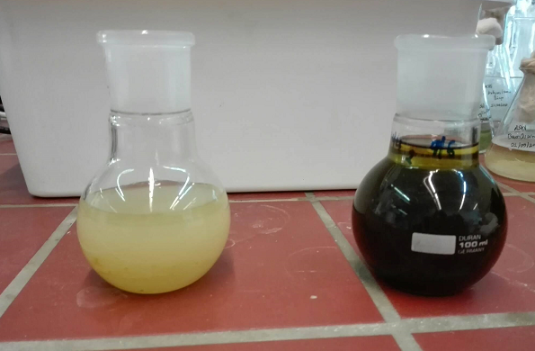
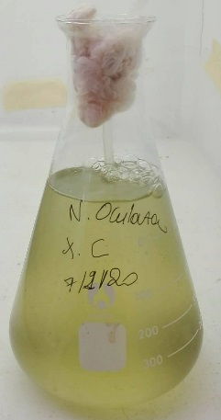
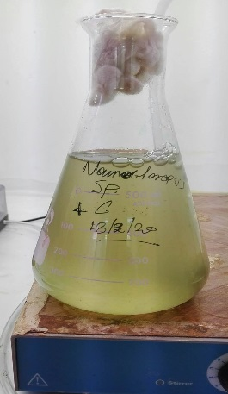
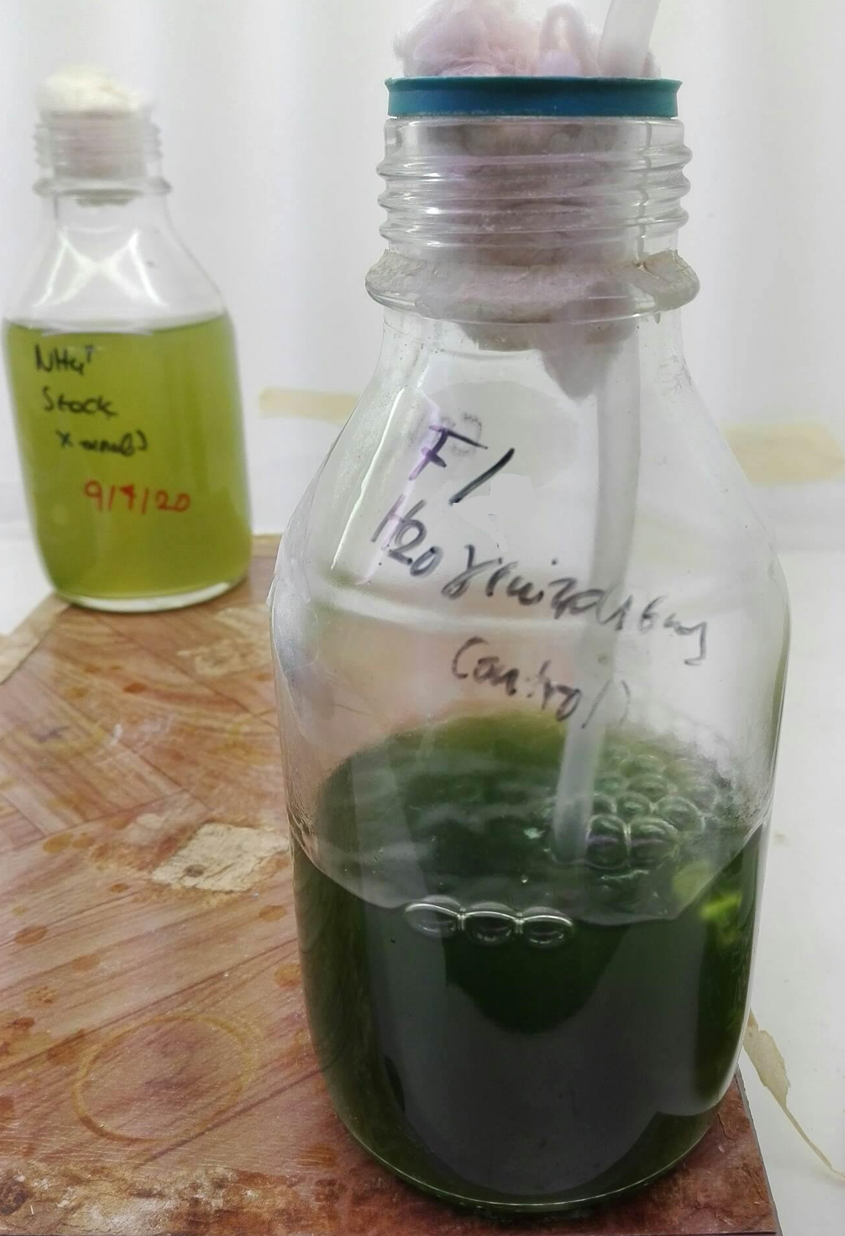
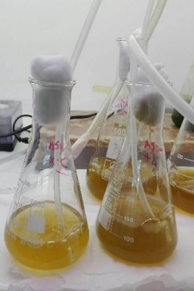
Cultivation of marine microalgae - Production of biomass and
high value added products
V. Patrinou¹, A. Daskalaki², C.N. Economou³, D. Bokas⁴, D.V. Vayenas³, G. Aggelis² and A.G. Tekerlekopoulou¹
¹Department of Environmental Engineering, University of Patras, G. Seferi 2, Agrinio 30100, Greece
²Department of Biology, University of Patras, Patras 26500, Greece
³Department of Chemical Engineering, University of Patras, Patras 26500, Greece
⁴PLAGTON S.A., Thesi Konaki Skentou, Municipality of Xiromero, Aitoloakarnania, Greece
INTRODUCTION AND METHODS
RESULTS
RESULTS
LIPID
ANALYSIS
Marine microalgae are considered versatile cellular factories that produce a plethora of metabolic compounds. The broad range of high value added components they produce contains mainly lipids, carbohydrates and proteins. The addition of microalgal biomass into the diets of cultivated fish is beneficial as it leads to improved growth and fillet quality, increased deposition of proteins in muscle tissue, improved resistance to disease, and higher fatty acid content.
In this work, four marine microalgae were studied (Figure 1). Nannochloropsis sp., Nannochloropsis oculata, Isochrysis galbana and Tetraselmis striata, are currently of high interest for aquafeeds and have the potential to produce important lipids. The study aimed to determine the most suitable microalga for full-scale production (Figure 2, Table 1). The strains were cultivated in drilling seawaters, and specific growth rate and biomass productivity were the determining parameters for the selection of the optimum microalga. Growth medium optimization was then performed for the chosen strain. Subsequent fatty acid analysis revealed significant eicosapentaenoic acid (EPA) and polyunsaturated fatty acid (PUFA) contents when the microalga was cultivated in the optimized growth medium.
The highest biomass productivity (47.6 mg L⁻¹d⁻¹) was recorded in the 29 ‰ medium indicating that T. striata prefers lower salinities (Table 2).
The lipids produced under the optimum growth conditions (29 ‰ seawater, Nutri-Leaf with NaHCO₃) were transesterified (Figure 6) to determine their fatty acid composition using gas chromatography (Table 4).
Table 2. Biomass productivities, specific growth rates and lipid contents of T. striata obtained using substrates B and C.
Substrate | Biomass productivity (mg L⁻¹ d⁻¹) | Specific growth rate (d⁻¹) | % d.w Lipid content
B | 40.0 | 0.129 | 10.3
C | 47.6 | 0.184 | 13.5
Figure 6. Fatty acid methyl esters.
The effect of substrate composition on growth was also evaluated in 29 ‰ seawater by further enriching the medium with the commercial fertilizer Nutri-Leaf (30% TN, 10% P, 10% K) together with NaHCO₃ (Figure 4).
Table 4. Fatty acid composition of the produced lipids.
 | Fatty acids (% w/w)
Substrate | C14:0 | C16:0 | C16:1 | C18:1 n-9 | C18:2 | C20:1 n-9 | C20:5 n-3 (ΕPA) | Sum of ΣPUFAs | Sum of ΣMUFAs & ΣSFAs
D | 4.8 | 18.5 | 24.7 | 8.3 | 5.1 | 3.1 | 27.6 | 33.2 | 60.3
Figure 2. Biomass production achieved from the four marine microalgae using substrate A.
Nannochloropsis strains presented the lowest biomass yields (Table 1). Isochrysis galbana exhibited the highest biomass productivity although the culture was susceptible to contamination. Tetraselmis striata was the optimum species, as it presented satisfactory biomass yields under conditions of high salinity and low nutrient availability.
Table 4 presents the composition of the dominant fatty acids produced. Polyunsaturated fatty acids (PUFAs) of high nutritional value such as eicosapentaenoic acid (EPA) were detected (27.6% of the total lipids). The sum of PUFAs was also high at 33.2%. The maximum sum of monosaturated (MUFAs) and saturated (SFAs) fatty acids recorded was 60.3%. The achieved EPA and PUFA contents are among the highest recorded for Tetraselmis strains in the relative bibliography. Thus, under the optimum growth conditions the accumulated lipids enhanced the nutritional value of the produced biomass.
Cultivation conditions:
500 mL Erlenmeyer flasks
Sterilized growth medium
Cultivation under non-aseptic conditions
Continuous illumination of 56 μmol m⁻² s⁻¹
Unregulated temperature (24-27ºC)
Unregulated pH (7.5-8.5)
Moderate stirring
Table 1. Biomass productivities and specific growth rates obtained from the four marine microalgae using substrate A.
Strain | Biomass productivity (mg L⁻¹ d⁻¹) | Specific growth rate (d⁻¹)
Nannochloropsis sp. | 23.2 | 0.073
Nannochloropsis oculata | 27.0 | 0.077
Tetraselmis striata | 40.2 | 0.101
Isochrysis galbana | 95.2 | 0.366
Figure 4. Effect of substrate composition on T. striata growth.
CONCLUSIONS
Tested substrates:
38 ‰ seawater supplemented with N,P at a ratio of 5:1 (substrate A)
38 ‰ seawater supplemented with N,P at a ratio of 12:1 (substrate B)
29 ‰ seawater supplemented with N,P at a ratio of 12:1 (substrate C)
29 ‰ seawater supplemented with the commercial fertilizer Nutri-Leaf and NaHCO₃ (substrate D)
The results of this study indicate that the marine microalgae T. striata is suitable for full-scale applications and can achieve significant biomass yields. Additionally, the strain is an important PUFA producer and its high nutritional value indicates its suitability for incorporation into aquafeeds.
Substrate optimization was performed to further enhance growth. A medium of N:P ratio (12:1) was studied in 38 ‰ and 29 ‰ seawaters. Figure 3 presents the recorded effect of salinity on biomass production.
Bibliography:
- Shah, M.R., Lutzu, G.A., Alam, A., Sarker, P., Kabir Chowdhury, M.A, Parsaeimehr, A., Liang, Y., Daroch, M., 2018, Microalgae in aquafeeds for a sustainable aquaculture industry. Journal of Applied Phycology, 30, 197–213.
- Imamoglu, E.; Demirel, Z.; Conk Dalay, M., 2015, Process optimization and modeling for the cultivation of Nannochloropsis sp. and Tetraselmis striata via response surface methodology. Journal of Phycology, 5, 442–453; DOI: org/10.1111/jpy.12286.
Figure 5. Effect of substrate on T. striata lipid production.
Acknowledgement: The project "Large-scale cultivation of microalgae and utilization of the biomass produced as alternative raw material in fish feed - AlgaFeed4Fish" (MIS 5045858, FK 80916), was co-funded by European (European Regional Development Fund) and National Resources (General Secretariat for Research and Technology) in the context of the Operational Program "Competitiveness, Entrepreneurship and Innovation (EPANEK, NSRF 2014-2020), specifically through the Action "Special Actions“ - "Aquacultures" - "Industrial Materials" - "Open Innovation in Culture".
(a) (b)
Table 3. Biomass productivity, specific growth rate and lipid content of T. striata cultivated on substrate D.
Substrate | Biomass productivity (mg L⁻¹ d⁻¹) | Specific growth rate (d⁻¹) | % d.w Lipid content
D | 79.8 | 0.266 | 27.8
(c) (d)
Using Nutri-Leaf significantly enhanced the recorded biomass productivity (79.8 mg L⁻¹d⁻¹ with a corresponding growth rate of 0.266 d⁻¹), while the produced biomass also contained high lipid contents of up to 27.8% dry weight (Figure 5, Table 3).
Figure 1. Marine microalgae studied: (a) Nannochloropsis oculata; (b) Nannochloropsis sp.; (c) Tetraselmis striata; (d) Isochrysis galbana
Figure 3. Effect of salinity on growth of T. striata.

